Slide 1
CSE 417T Introduction to Machine Learning
Lecture 12 Instructor: Chien-Ju (CJ) Ho

Slide 2
Logistics
Homework 2: due on Oct 7 (Friday)
Exam 1: October 27 (Thursday)
Topics: LFD Chapters 1 to 5
Timed exam (75 min) during lecture time
Location TBD
Closed-book exam with 2 letter-size cheat sheets allowed (4 pages in total)
No format limitations (it can be typed, written, or a combination)
Homework 3 will be posted later today or tomorrow
Expected due: Mar 5 (Saturday)

Slide 3
Recap

Slide 4
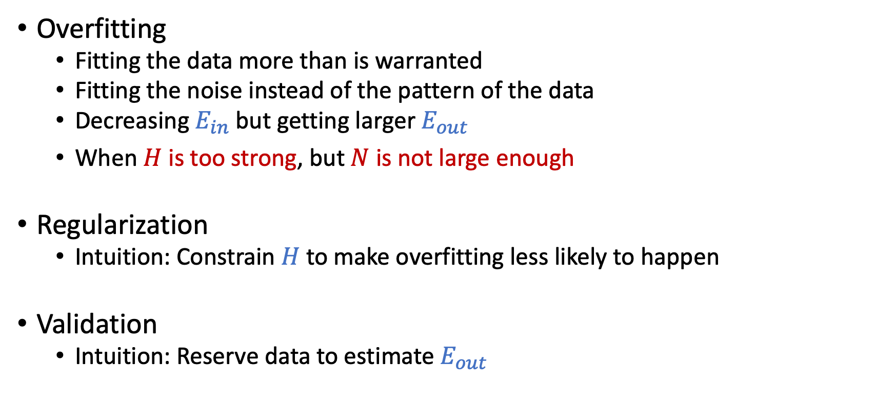
Overfitting and Its Cures
Overfitting
Fitting the data more than is warranted
Fitting the noise instead of the pattern of the data
Decreasing $E_{in}$ but getting larger $E_{out}$
When $H$ is too strong, but $N$ is not large enough
Regularization
Intuition: Constrain $H$to make overfitting less likely to happen
Validation
Intuition: Reserve data to estimate $E_{out}$

Slide 5
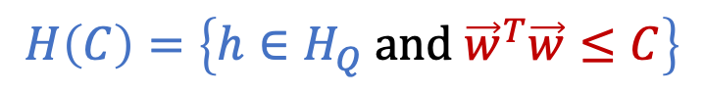
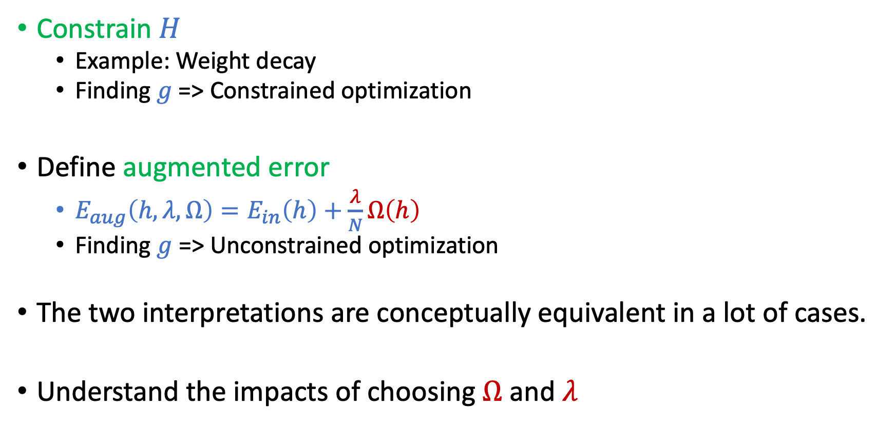
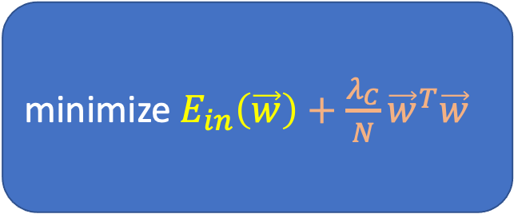
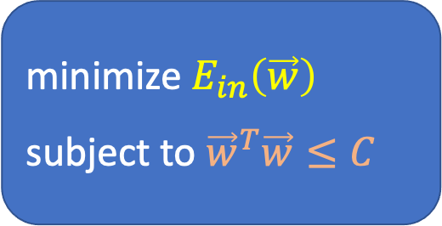
Regularization
minimize $E_{in}\left(\vec{w}\right)$
subject to ${\vec{w}}^{T}\vec{w}≤C$
Constrain $H$
Example: Weight decay
Finding $g$=> Constrained optimization
Define augmented error
$E_{aug}\left(h,λ,Ω\right)=E_{in}\left(h\right)+\frac{λ}{N}Ω\left(h\right)$
Finding $g$ => Unconstrained optimization
The two interpretations are conceptually equivalent in a lot of cases.
Understand the impacts of choosing $Ω$ and $λ$
$$H\left(C\right)=\left\{h∈H_{Q} \text{and} {\vec{w}}^{T}\vec{w}≤C\right\}$$
minimize $E_{in}\left(\vec{w}\right)+\frac{λ_{C}}{N}{\vec{w}}^{T}\vec{w}$

Slide 6
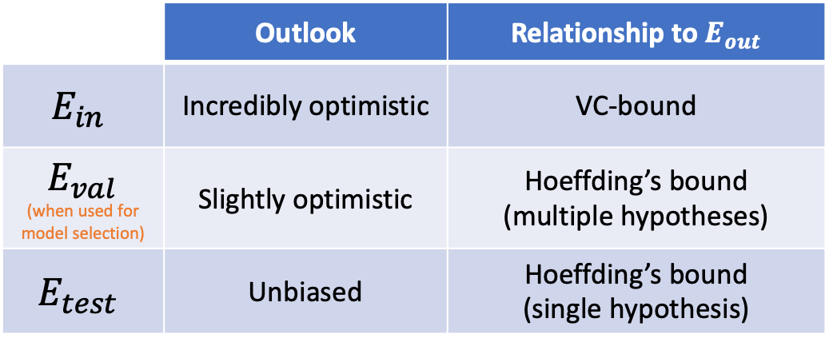
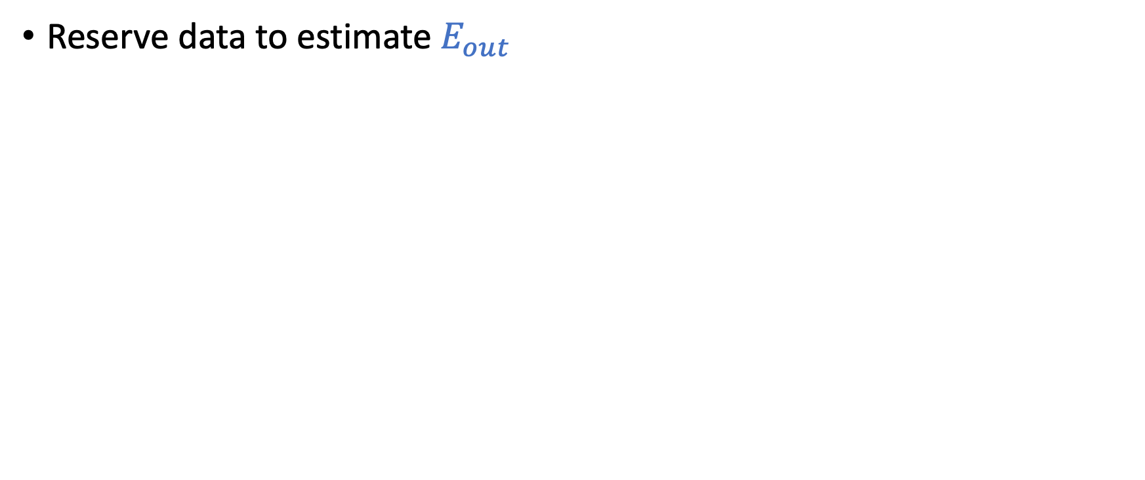
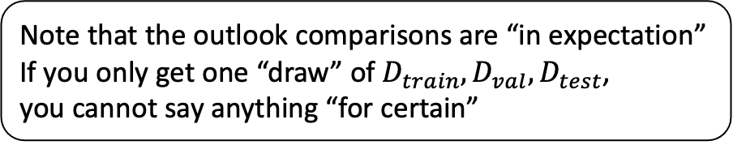
Validation
Note that the outlook comparisons are “in expectation”
If you only get one “draw” of $D_{train}, D_{val}, D_{test}$, you cannot say anything “for certain”
Reserve data to estimate $E_{out}$
 | Outlook | Relationship to $E_{out}$
$$E_{in}$$ | Incredibly optimistic | VC-bound
$$E_{val}$$ (when used for model selection) | Slightly optimistic | Hoeffding’s bound (multiple hypotheses)
$$E_{test}$$ | Unbiased | Hoeffding’s bound (single hypothesis)
Model Selection
Cross Validation

Slide 7
Today’s Lecture
The notes are not intended to be comprehensive. They should be accompanied by lectures and/or textbook.
Let me know if you spot errors.

Slide 8
Three Learning Principles

Slide 9
Occam’s Razor
Sampling Bias
Data Snooping

Slide 10

Occam’s Razor
“An explanation of the data should be made as simple as possible, but no simpler.” -- Einstein?
“entia non sunt multiplicanda praeter necessitatem”
(entities must not be multiplied beyond necessity)
-- William of Occam
“trimming down”
unnecessary explanation

Slide 11
The simplest model that fits the data is also the most plausible
What does it mean to be simple?
Why is simple better?

Slide 12
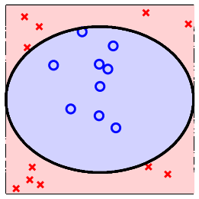
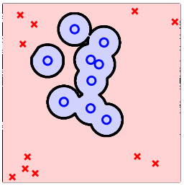
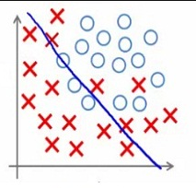
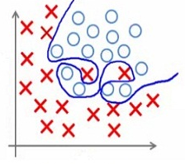

Slide 13
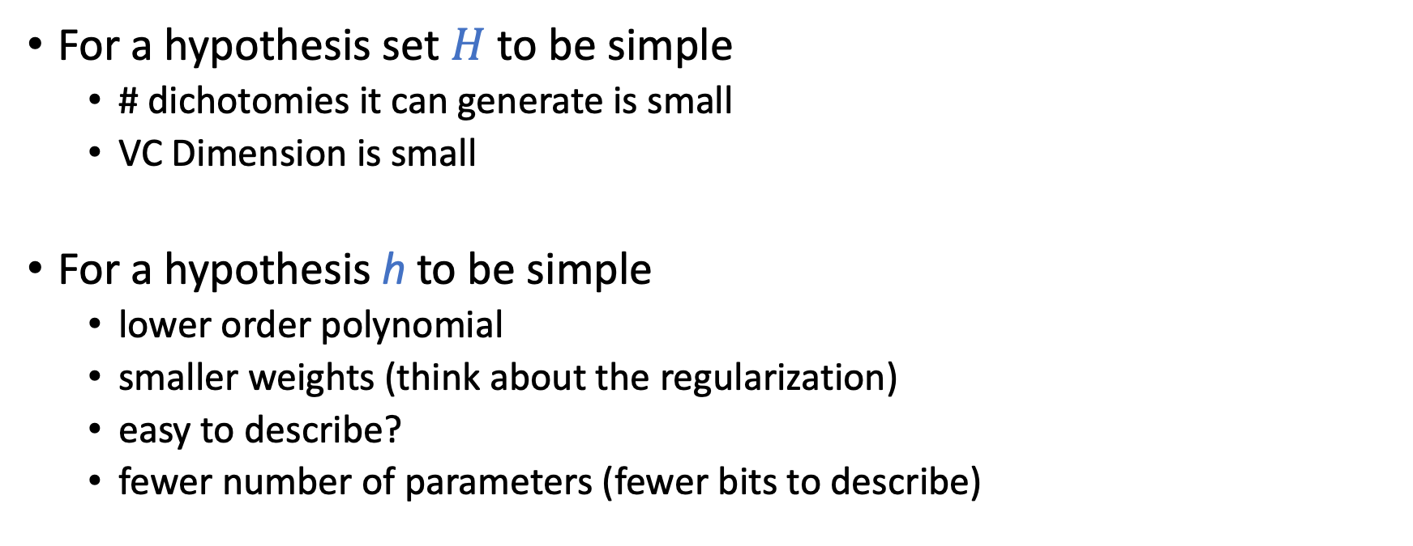
Simple Model?
For a hypothesis set $H$ to be simple
# dichotomies it can generate is small
VC Dimension is small
For a hypothesis h to be simple
lower order polynomial
smaller weights (think about the regularization)
easy to describe?
fewer number of parameters (fewer bits to describe)

Slide 14
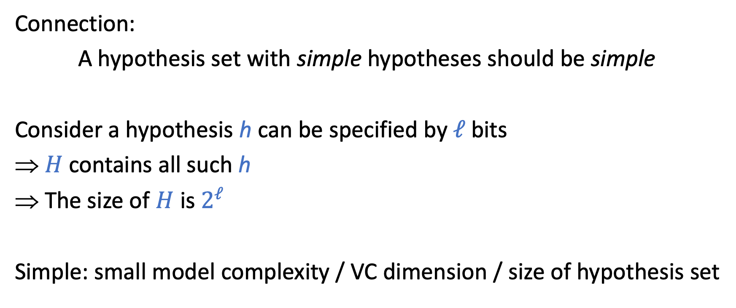
Simple Model?
Connection:
A hypothesis set with simple hypotheses should be simple
Consider a hypothesis h can be specified by $ℓ$bits
$H$contains all such h
The size of $H$ is $2^{ℓ}$
Simple: small model complexity / VC dimension / size of hypothesis set

Slide 15
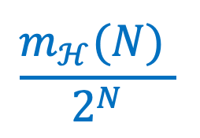
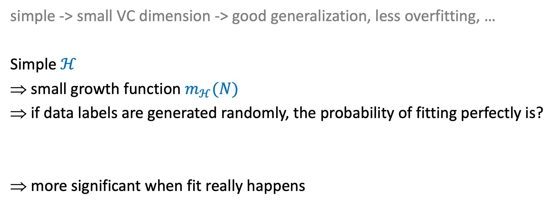
Why is Simple Better?
simple -> small VC dimension -> good generalization, less overfitting, …
Simple $ℋ$
small growth function $m_{ℋ}(N)$
if data labels are generated randomly, the probability of fitting perfectly is?
more significant when fit really happens
$$\frac{m_{ℋ}(N) }{2^{N}}$$

Slide 16
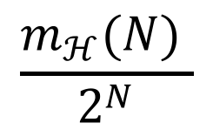
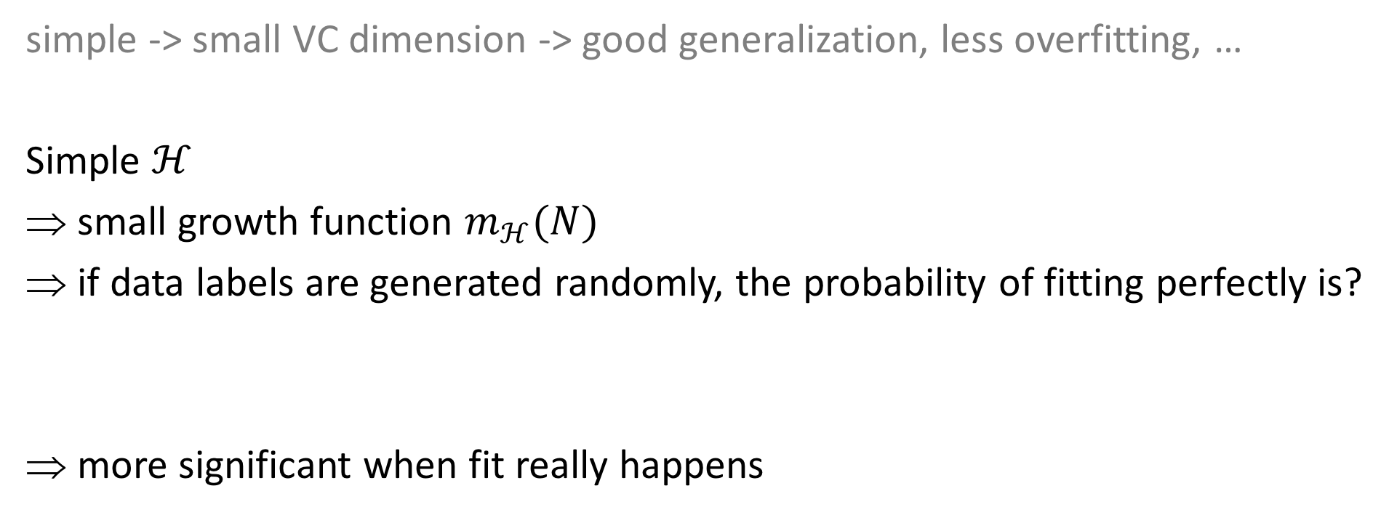
Why is Simple Better?
simple -> small VC dimension -> good generalization, less overfitting, …
Simple $ℋ$
small growth function $m_{ℋ}(N)$
if data labels are generated randomly, the probability of fitting perfectly is?
more significant when fit really happens
$$\frac{m_{ℋ}(N) }{2^{N}}$$
Falsifiability is important!

Slide 17
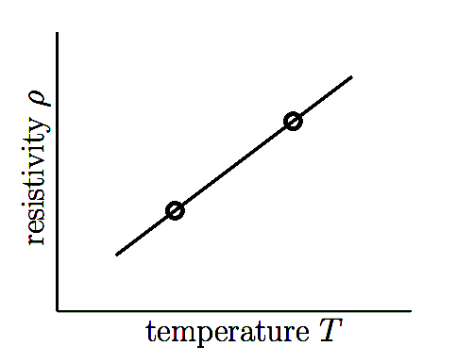
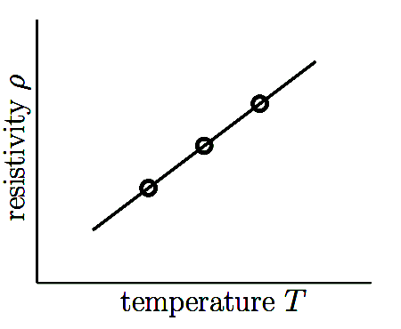
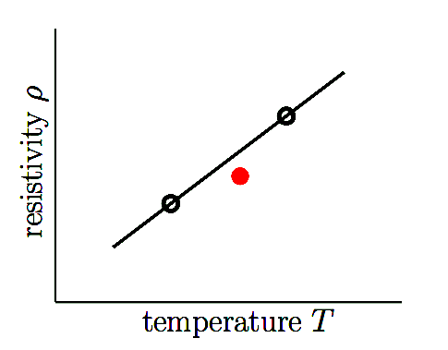
Falsifiability
Say you want to examine whether resistivity is linear in temperature
(assume no measure error)

Slide 18
A Classical Puzzle
Imagine you got an email before each Cardinals game for the first 5 games.
Before Game 1: “Cardinals will win” -> Cardinals wins Game 1
Before Game 2: ”Cardinals will lose” -> Cardinals loses Game 2
….
Before Game 6:
If you pay me $50 dollars, I’ll tell you whether Cardinals will win or not
It’s not falsifiable:
Imagine if this person contacts 2¹⁰ persons, split them into two groups each game
2⁵ persons will receive perfect prediction for the first 5 games

Slide 19
Occam’s Razor
Sampling Bias
Data Snooping

Slide 20
1948 US Presidential Election
Truman vs. Dewey
Chicago Daily Tribune decided to run a phone poll of how people voted

Slide 21
Truman

Slide 22
What happened?
One explanation: we cannot claim anything for certain.
However, there are bigger issues here…
Phones are expensive in 1948…
Dewey was more favored in rich populations
Imagine you are polling from people in DC/Texas/NY to predict who will win the presidential election…

Slide 23
Sampling Bias
If the data is sampled in a biased way, learning will produce a similarly biased outcome.

Slide 24
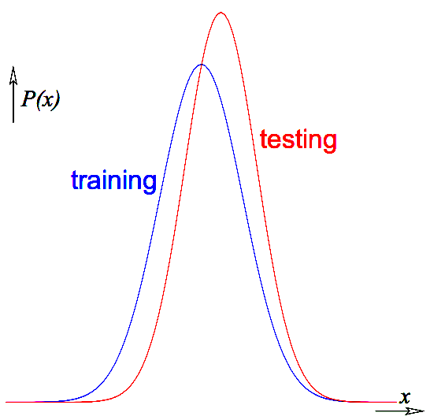
What can we do….
Make sure the training and test distributions are as close as possible…
Example: importance weighting
Not always possible….
If you don’t have access to some region of points in training, but they appear in the testing distribution

Slide 25
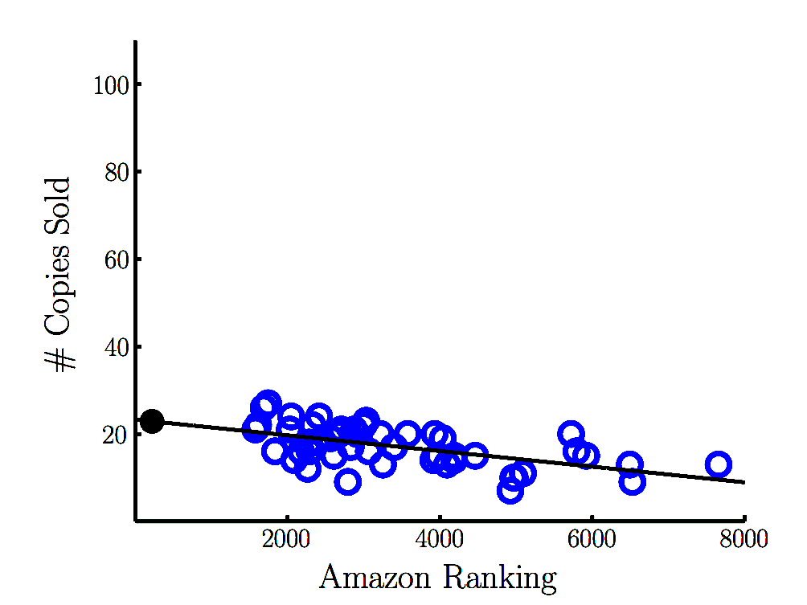

Slide 26
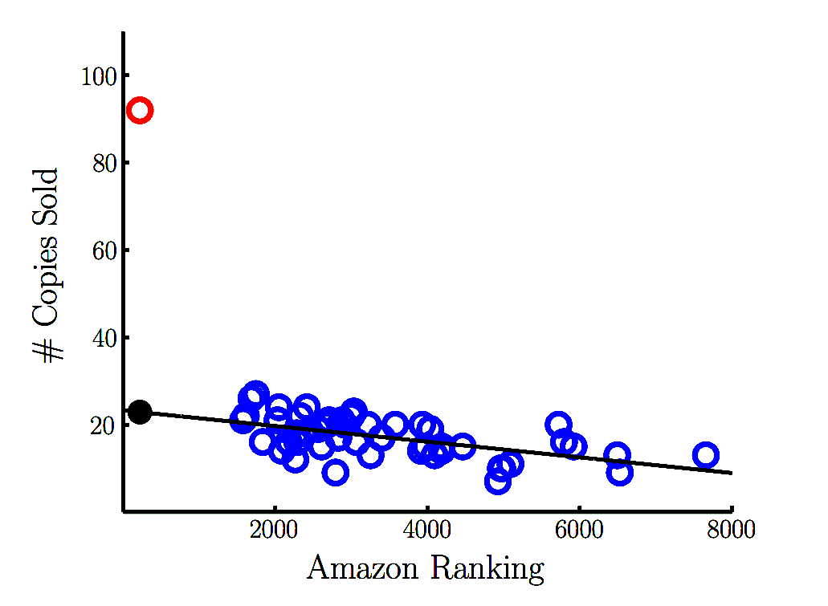

Slide 27
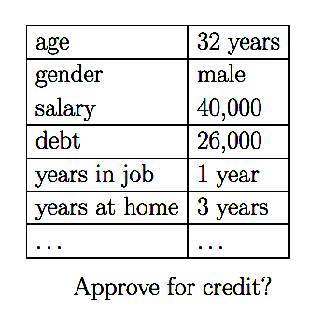
Credit card example
Determine whether to approve credit cards given applicants’ financial information
Banks have lots of data:
Customer information
Whether they are good customers or not
Are there any issues here?

Slide 28
We will spend 1~2 lectures towards the end of the semester to talk about various ethical considerations of ML.

Slide 29
Occam’s Razor
Sampling Bias
Data Snooping

Slide 30
Data Snooping
If a data set has affected any step in the learning process, its ability to assess the outcome has been compromised.

Slide 31
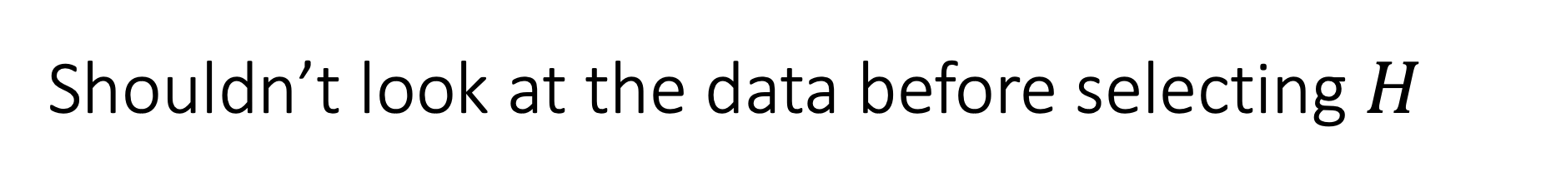
Shouldn’t look at the data before selecting $H$

Slide 32
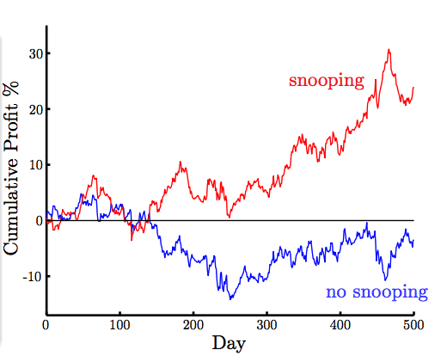
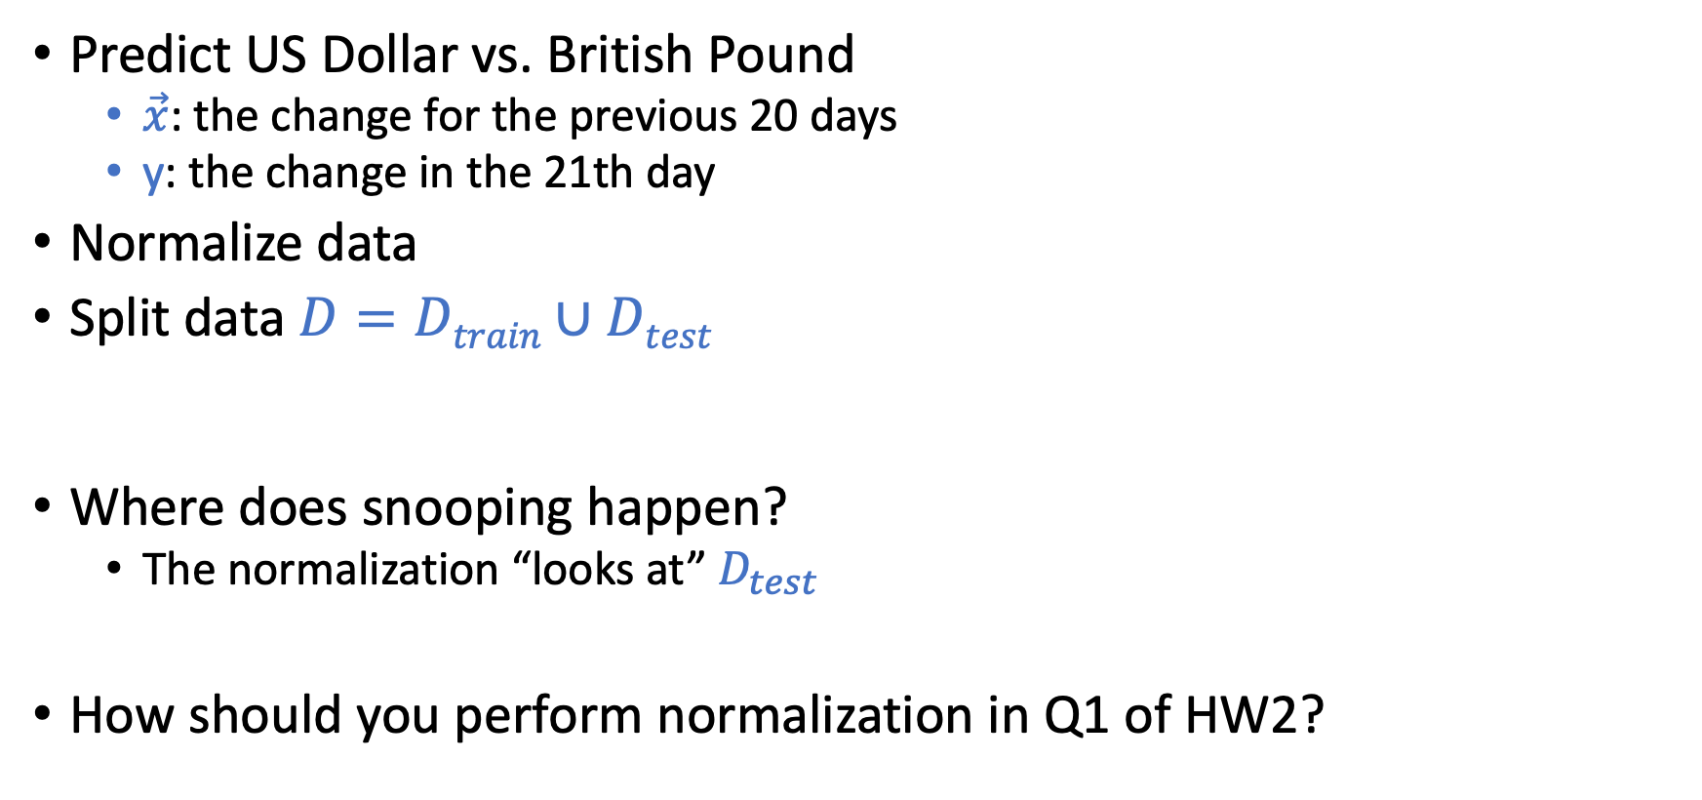
A Subtle Example
Predict US Dollar vs. British Pound
$\vec{x}$: the change for the previous 20 days
y: the change in the 21th day
Normalize data
Split data $D=Dtrain∪Dtest$
Where does snooping happen?
The normalization “looks at” $D_{test}$
How should you perform normalization in Q1 of HW2?

Slide 33
Reuse of a Data Set
Try one model after another on the same data set, you will eventually succeed.
“If you torture the data long enough, it will confess”
VC dimension of the total learning models
May even include what others tried (e.g., if you read their paper…)
p-hacking…

Slide 34
From xkcd, by Randall Munroe: http://xkcd.com/882

Slide 35
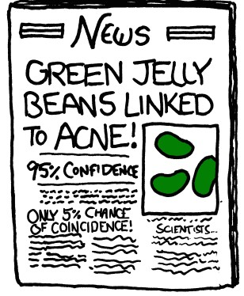
From xkcd, by Randall Munroe: http://xkcd.com/882

Slide 36
What Should We Do…
Avoid data snooping
Strict discipline
E.g., be honest and lock the test data
Account for data snooping
Measure how much data is contaminated
E.g., what we discussed in validation

Slide 37
Occam’s Razor
Sampling Bias
Data Snooping

Slide 38
Content of Exam 1 Till Here

Slide 39
Course Plan
Foundations
What’s machine learning
Feasibility of learning
Generalization
Linear models
Non-linear transformations
Overfitting and how to avoid it
Regularization
Validation
Techniques
Decision tree
Ensemble learning
Bagging and random forest
Boosting and Adaboost
Nearest neighbors
Support vector machine
Neural networks
…

Slide 40
Decision Tree

Slide 41
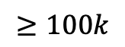
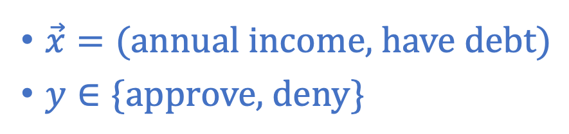
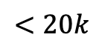
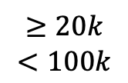
Decision Tree Hypothesis
Annual Income
$$≥100k$$
$$≥20k$$
$$<100k$$
$$<20k$$
$\vec{x}=(\text{annual} \text{income}\text{, }\text{have} \text{debt})$
$y∈\{\text{approve}\text{, }\text{deny}\}$
Approve
have debt?
Deny
Deny
yes
no
Deny
Deny
Approve
Approve
Credit Card Approval Example

Slide 42
Decision Tree Hypothesis
Pros
Easy to interpret (interpretability is getting attention and is important in many domains)
Can handle multi-type data (Numerical, categorical. …)
Easy to implement (Bunch of if-else rules)
Cons
Generally speaking, bad generalization
VC dimension is infinity
High variance (small change of data leads to very different hypothesis)
Easily overfit
Why we care?
One of the classical model
Building block for other models (e.g., random forest)
Annual Income
$$≥100k$$
$$≥20k$$
$$<100k$$
$$<20k$$
Approve
have debt?
Deny
Deny
yes
no
Deny
Deny
Approve
Approve
Credit Card Approval Example

Slide 43
Decision Tree Hypothesis
Pros
Easy to interpret (interpretability is getting attention and is important in many domains)
Can handle multi-type data (Numerical, categorical. …)
Easy to implement (Bunch of if-else rules)
Cons
Generally speaking, bad generalization
VC dimension is infinity
High variance (small change of data leads to very different hypothesis)
Easily overfit
Why we care?
One of the classical models
Building block for other models (e.g., random forest)
Annual Income
$$≥100k$$
$$≥20k$$
$$<100k$$
$$<20k$$
Approve
have debt?
Deny
Deny
yes
no
Deny
Deny
Approve
Approve
Credit Card Approval Example

Slide 44
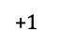
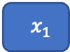
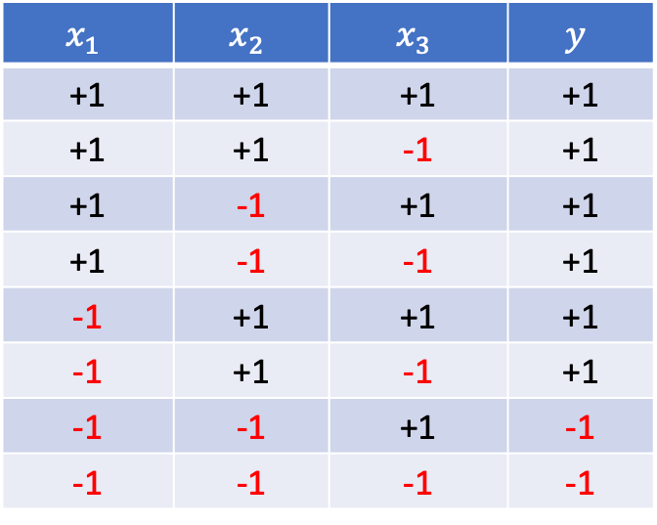
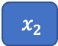
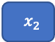
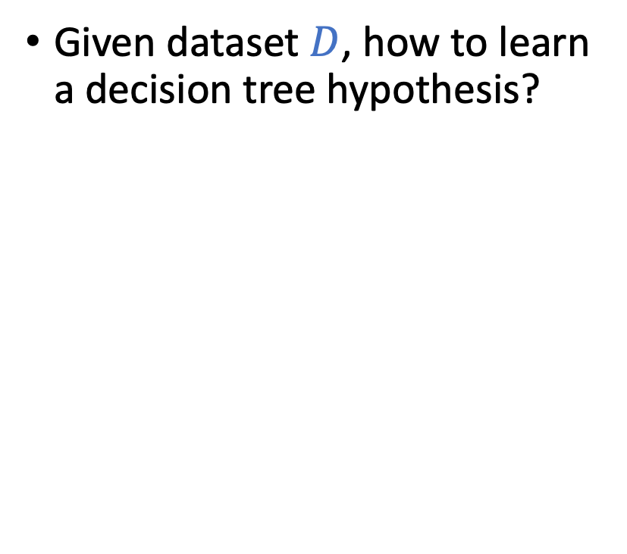
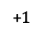
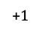
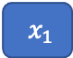
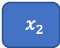
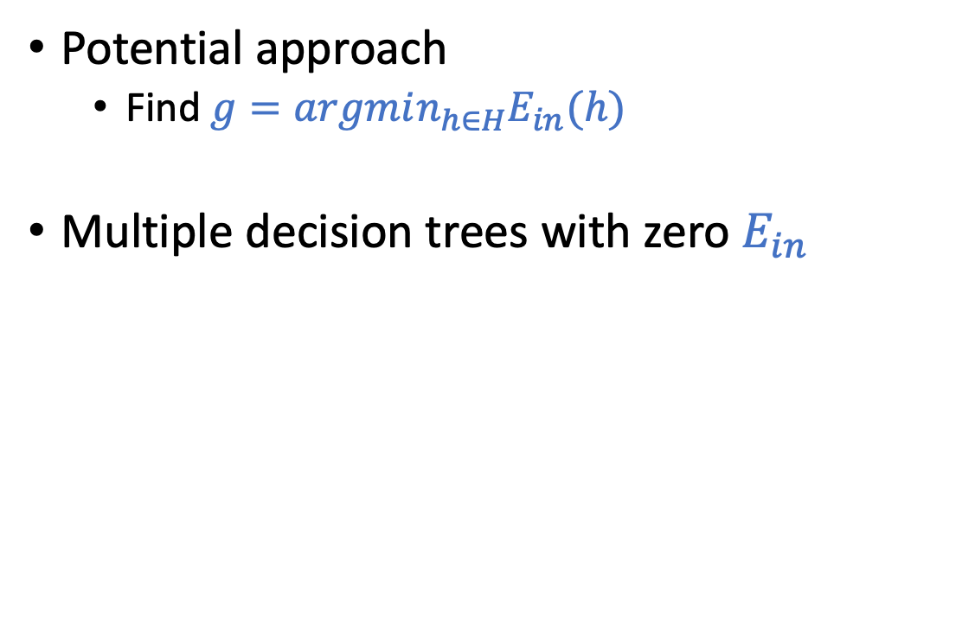
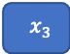
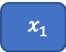
Learning Decision Tree from Data
Given dataset $D$, how to learn a decision tree hypothesis?
Potential approach
Find $g=argmin_{h∈H}E_{in}(h)$
Multiple decision trees with zero $E_{in}$
$$x_{1}$$ | $$x_{2}$$ | $$x_{3}$$ | $$y$$
+1 | +1 | +1 | +1
+1 | +1 | -1 | +1
+1 | -1 | +1 | +1
+1 | -1 | -1 | +1
-1 | +1 | +1 | +1
-1 | +1 | -1 | +1
-1 | -1 | +1 | -1
-1 | -1 | -1 | -1
$$x_{1}$$
$$x_{3}$$
+1
-1
+1
-1
$$x_{2}$$
$$x_{2}$$
+$1$
$$x_{2}$$
+1
+1
-1
+1
-1
+1
-1
+$1$
+$1$
$$x_{1}$$
+1
$$x_{1}$$
+1
+$1$
-1
+1
-1
+1
-1
+1
-1
+1
+1
-1
+1
-1
+1
-1
Which one do you think might generalize better?

Slide 45
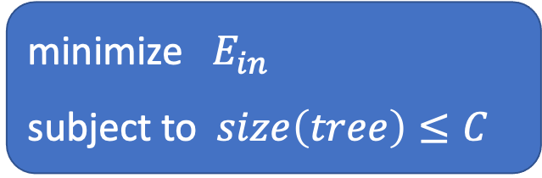
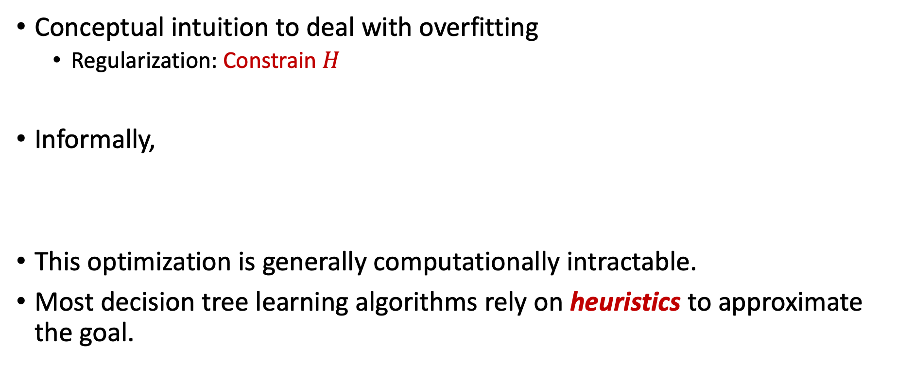
Learning Decision Tree from Data
Conceptual intuition to deal with overfitting
Regularization: Constrain $H$
Informally,
This optimization is generally computationally intractable.
Most decision tree learning algorithms rely on heuristics to approximate the goal.
minimize $E_{in}$
subject to $size\left(tree\right)≤C$

Slide 46
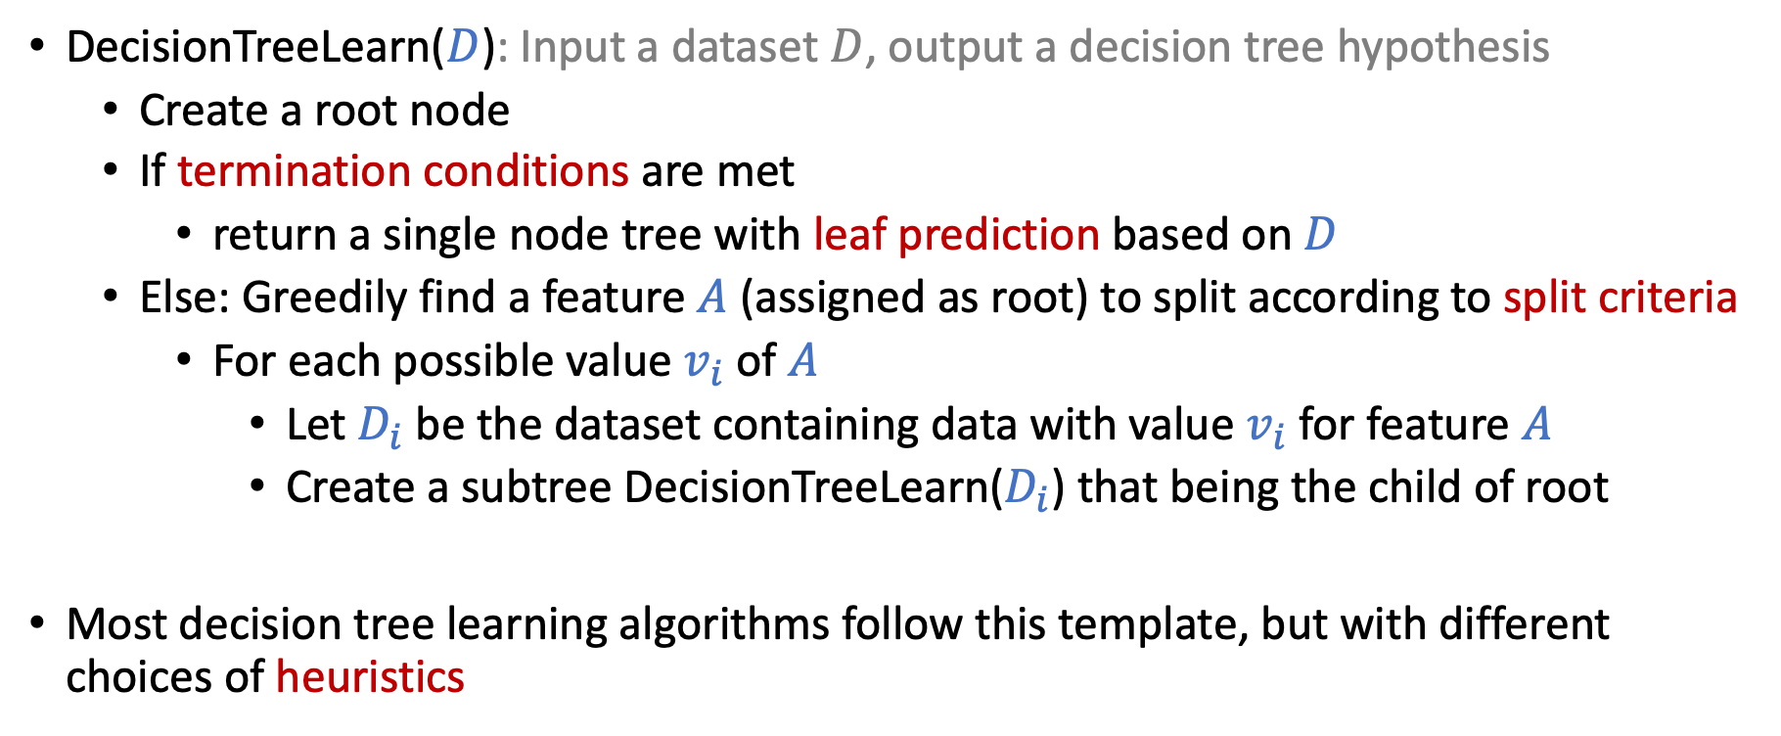
Template of Greedy-Based Decision Tree Algorithm
DecisionTreeLearn($D$): Input a dataset $D$, output a decision tree hypothesis
Create a root node
If termination conditions are met
return a single node tree with leaf prediction based on $D$
Else: Greedily find a feature $A$ (assigned as root) to split according to split criteria
For each possible value $v_{i}$ of $A$
Let $D_{i}$ be the dataset containing data with value $v_{i}$ for feature $A$
Create a subtree DecisionTreeLearn($D_{i}$) that being the child of root
Most decision tree learning algorithms follow this template, but with different choices of heuristics

Slide 47
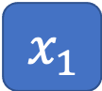




Example
DecisionTreeLearn($D$)
Create a root node
If termination conditions are met
return a single node tree with leaf prediction based on $D$
Else: Greedily find a feature $A$ (assigned as root) to split according to split criteria
For each possible value $v_{i}$ of $A$
Let $D_{i}$ be the dataset containing data with value $v_{i}$ for feature $A$
Create a subtree DecisionTreeLearn($D_{i}$) that being the child of root
Termination conditions not net
Find a feature to split
$$x_{1}$$
$$x_{1}$$ | $$x_{2}$$ | $$x_{3}$$ | $$y$$
+1 | +1 | +1 | +1
+1 | +1 | -1 | +1
+1 | -1 | +1 | +1
+1 | -1 | -1 | +1
-1 | +1 | +1 | +1
-1 | +1 | -1 | +1
-1 | -1 | +1 | -1
-1 | -1 | -1 | -1
+1
-1
DecisionTreeLearn
$$x_{1}$$ | $$x_{2}$$ | $$x_{3}$$ | $$y$$
+1 | +1 | +1 | +1
+1 | +1 | -1 | +1
+1 | -1 | +1 | +1
+1 | -1 | -1 | +1
$$x_{1}$$ | $$x_{2}$$ | $$x_{3}$$ | $$y$$
-1 | +1 | +1 | +1
-1 | +1 | -1 | +1
-1 | -1 | +1 | -1
-1 | -1 | -1 | -1
DecisionTreeLearn
DecisionTreeLearn
terminate
Don’t terminate
Leaf prediction +1
Find next feature to split

Slide 48



Example Heuristics
$$x_{1}$$
+1
-1
DecisionTreeLearn($D$)
Create a root node
If termination conditions are met
return a single node tree with leaf prediction based on $D$
Else: Greedily find a feature $A$ to split according to split criteria
For each possible value $v_{i}$ of $A$
Let $D_{i}$ be the dataset containing data with value $v_{i}$ for feature $A$
Create a subtree DecisionTreeLearn($D_{i}$) that being the child of root
$$x_{1}$$ | $$x_{2}$$ | $$x_{3}$$ | $$y$$
+1 | +1 | +1 | +1
+1 | +1 | -1 | +1
+1 | -1 | +1 | +1
+1 | -1 | -1 | +1
$$x_{1}$$ | $$x_{2}$$ | $$x_{3}$$ | $$y$$
-1 | +1 | +1 | +1
-1 | +1 | -1 | +1
-1 | -1 | +1 | -1
-1 | -1 | -1 | -1
DecisionTreeLearn
DecisionTreeLearn
terminate
Don’t terminate
Leaf prediction +1
Find next feature to split
Termination conditions
When the dataset is empty
When all labels are the same
when all features are the same
When the depth of the tree is too deep
…
Leaf predictions
Majority voting
Average (for regression)
…
Split criteria?

Slide 49

Split Criteria
Which feature would you choose to split?
$$x_{1}$$ | $$x_{2}$$ | $$y$$
+1 | +1 | +1
+1 | -1 | +1
-1 | +1 | -1
-1 | -1 | -1

Slide 50






Split Criteria
Which feature would you choose to split?
Want the tree to be “smaller”
Intuition: choose the one that the labels in the subtrees are more “pure”
Example: choose the one maximizing information gain => ID3 Algorithm
$$x_{1}$$ | $$x_{2}$$ | $$y$$
+1 | +1 | +1
+1 | -1 | +1
-1 | +1 | -1
-1 | -1 | -1
$$x_{1}$$
$$x_{2}$$
+1
-1
+1
-1
$$x_{1}$$ | $$x_{2}$$ | $$y$$
+1 | +1 | +1
+1 | -1 | +1
$$x_{1}$$ | $$x_{2}$$ | $$y$$
-1 | +1 | -1
-1 | -1 | -1
$$x_{1}$$ | $$x_{2}$$ | $$y$$
+1 | +1 | +1
-1 | +1 | -1
$$x_{1}$$ | $$x_{2}$$ | $$y$$
+1 | -1 | +1
-1 | -1 | -1

Slide 51


Brief Intro to Information Entropy
Assume there are $K$ possible labels
Entropy:
$H\left(D\right)=\sum_{i=1}^{K}{p_{i}\log_{2}{\frac{1}{p_{i}}}}$
$p_{i}:$ ratio of points with label $i$ in the data
By definition
$$0\log_{2}{\frac{1}{0}=0}; 1\log_{2}{\frac{1}{1}=0}$$
Interpretations of entropy
Expected # bit to encode a distribution
Higher entropy
data is less “pure”
”pure” data => all labels are +1 or -1 => entropy = 0

Slide 52



Brief Intro to Information Entropy
Assume there are $K$ possible labels
Entropy:
$H\left(D\right)=\sum_{i=1}^{K}{p_{i}\log_{2}{\frac{1}{p_{i}}}}$
$p_{i}:$ ratio of points with label $i$ in the data
Binary case with $K=2$
By definition
$$0\log_{2}{\frac{1}{0}=0}; 1\log_{2}{\frac{1}{1}=0}$$
Interpretations of entropy
Expected # bit to encode a distribution
Higher entropy
data is less “pure”
”pure” data => all labels are +1 or -1 => entropy = 0
$$H(D)$$
$$p_{1}$$

Slide 53
Brief Intro to Information Entropy
Assume there are $K$ possible labels
Entropy:
$H\left(D\right)=\sum_{i=1}^{K}{p_{i}\log_{2}{\frac{1}{p_{i}}}}$
$p_{i}:$ ratio of points with label $i$ in the data
Binary case with $K=2$
By definition
$$0\log_{2}{\frac{1}{0}=0}; 1\log_{2}{\frac{1}{1}=0}$$
Interpretations of entropy
Expected # bit to encode a distribution
Higher entropy
data is less “pure”
”pure” data => all labels are +1 or -1 => entropy = 0
Want to choose splits that lead to pure data, i.e., lower entropy
$$H(D)$$
$$p_{1}$$

Slide 54



ID3: Using Information Gain as Selection Criteria
Information gain of choosing feature $A$ to split
$Gain\left(D,A\right)=H\left(D\right)−\sum_{i}{\frac{\left|D_{i}\right|}{\left|D\right|}}H(D_{i})$ [The amount of decrease in entropy]
ID3: Choose the split that maximize $Gain\left(D,A\right)$
Notation:
$|D|$ is the number of points in $D$
DecisionTreeLearn($D$)
Create a root node
If termination conditions are met
return a single node tree with leaf prediction based on $D$
Else: Greedily find a feature $A$ to split according to split criteria
For each possible value $v_{i}$ of $A$
Let $D_{i}$ be the dataset containing data with value $v_{i}$ for feature $A$
Create a subtree DecisionTreeLearn($D_{i}$) that being the child of root
ID3 termination conditions
If all labels are the same
If all features are the same
If dataset is empty
ID3 leaf predictions
Most common labels (majority voting)
ID3 split criteria
Information gain

Slide 55
















ID3: Using Information Gain as Selection Criteria
Information gain of choosing feature $A$ to split
$Gain\left(D,A\right)=H\left(D\right)−\sum_{i}{\frac{\left|D_{i}\right|}{\left|D\right|}}H(D_{i})$
ID3: Choose the split that maximize $Gain\left(D,A\right)$
$$x_{1}$$
$$x_{2}$$
$$x_{1}$$ | $$x_{2}$$ | $$y$$
+1 | +1 | +1
+1 | -1 | +1
-1 | +1 | -1
-1 | -1 | -1
+1
-1
+1
-1
$$x_{1}$$ | $$x_{2}$$ | $$y$$
+1 | +1 | +1
+1 | -1 | +1
$$x_{1}$$ | $$x_{2}$$ | $$y$$
-1 | +1 | -1
-1 | -1 | -1
$$x_{1}$$ | $$x_{2}$$ | $$y$$
+1 | +1 | +1
-1 | +1 | -1
$$x_{1}$$ | $$x_{2}$$ | $$y$$
+1 | -1 | +1
-1 | -1 | -1
$$H\left(D_{x_{1}=1}\right)=0$$
$$H\left(D_{x_{1}=−1}\right)=0$$
$$H\left(D_{x_{2}=1}\right)=1$$
$$H\left(D_{x_{2}=−1}\right)=1$$
$$H\left(D\right)=0.5\log_{2}{2+0.5\log_{2}{2=1}}$$
$$Gain\left(D,x_{1}\right)=1$$
$$Gain\left(D,x_{2}\right)=0$$
ID3 will choose $x_{1}$ as the next split attribute

Slide 56

Further Addressing Overfitting
More Regularization (Constrain $H$)
Do not split leaves past a fixed depth
Do not split leaves with fewer than $c$ labels
Do not split leaves where the maximal information gain is less than $τ$
Pruning (removing leaves)
Evaluate each split using a validation set and compare the validation error with and without that split (replacing it with the most common label at that point)
Use statistical test to examine whether the split is “informative” (leads to different enough subtrees)

Slide 57

More Discussions
Real-valued features (continuous $x$)
Need to select threshold for branching
Regression (continuous $y$)
Change leaf prediction: e.g., average instead of majority vote
Change measure for “purity” of data: e.g., squared error of data

Slide 58
Ensemble Learning
The focus of the next two lectures

Slide 59

Ensemble Learning
Assume we are given a set of learned hypothesis
$g_{1}$, $g_{2}$, …, $g_{M}$
What can we do?
Use validation to pick the best one
What if all of them are not good enough
Can we aggregate them?

Slide 60
Is Aggregation a Good Idea?
At a 1906 country fair, ~800 people participate in a contest to guess the weight of an ox.
Reward is given to the person with the closest guess.
The average guess is 1,197lbs. The true answer is 1,198lbs.

Slide 61
Is Aggregation a Good Idea?
Maybe
If the hypothesis is “diverse”, and “on average” they seem good
Question:
How do we find a set of hypothesis that are diverse and “on average” good
How do we aggregate the set of hypothesis
Ensemble learning (Next Two Lectures)
Bagging – Random Forest
Boosting – AdaBoost

